Slide 1
Tree Pests
Creatures That Bug Our Trees
Jim DeYoung
Botany202

Slide 2
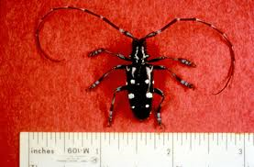
Asian Longhorn Beetle
Native to China
Transported to United States in infested packing material

Slide 3
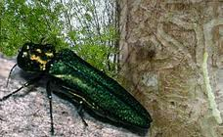
Emerald Ash Borer
Killed 20 million trees, in Michigan, Ohio, and Indiana
Firewood quarantines to prevent new infestations

Slide 4
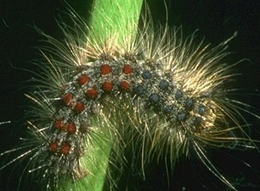
Gypsy Moth
Spread to U.S. in 1870
Oaks and Aspens are most common hosts
Larva defoliate trees
Small mammals and birds are predators

Slide 5
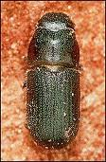
Western Pine Beetle
Infest Ponderosa and Coulter pine trees
Mainly Western states
Tree loss considered normal ecological process

Slide 6
Acknowledgemnents
Photos and information courtesy of the USDA Forest Service

