Slide 1
Paul Cezanne
Austin Hembree

Slide 2
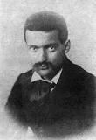
Background
•Born January 19, 1839, in Aix-en-Provence.
•Died October 22, 1906, in Aix-en-Provence.
•Entered the Collège Bourbon
•Dad want him to be in law school instead of an artist
He married in 1886 and had one son, Paul Cezanne, Jr.

Slide 3
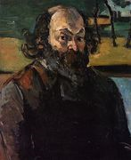
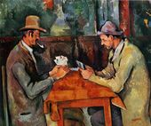
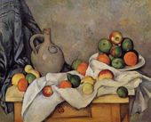
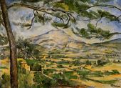
Art work and style
Cézanne was a modern artist whose work was a precursor for Cubism and Fauvism.
Cézanne was inspired by mostly by nature as he matured as a painter.

Slide 4
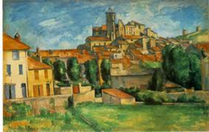
My art work VS His art work
In My art
work I decided to change the color of the buildings roof and I also took away some of the building.

Slide 5
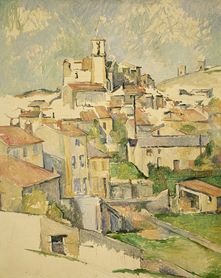
Critique
The time is some in autumn of 1885 and most of 1886.
Paul Cézanne, Gardanne, 1885-86, Oil on canvas
Paul uses different line thickness to show the size of walls and roofs, he also uses movement to help your eye move through the art work.
In this artwork there is many buildings that are all similar in design.
They mood seems to be calm and relaxing this piece would fit great in a dining room setting .
I personal enjoy this piece because I like looking at all the architecture in the building.

Slide 6
http://www.artble.com/artists/paul_cezanne
http://www.biography.com/people/paul-cezanne-9542036
http://www.paul-cezanne.org/biography.html

