Slide 1
Paul Cezanne
By Austin Hembree

Slide 2
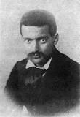
Background
•Paul Cezanne was born January 19, 1839, in Provence.
• Paul Cezanne died October 22, 1906, in Provence.
•Attended the Collège Bourbon
•His dad always wanted him to be in law school instead of an artist
He married in 1886 and had one son, Paul Cezanne, Jr.

Slide 3
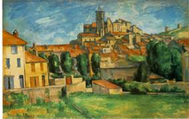
My art work VS His art work
In My art
work I decided to change the color of the buildings roof and I also took away some of the building , which allowed me to fit my canvas.

Slide 4
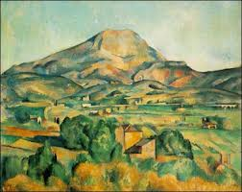
Critique

Slide 6
