Slide 1
Paul Cezanne
Austin Hembree

Slide 2
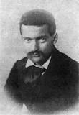
Background
•Born January 19, 1839, in Aix-en-Provence.
•Died October 22, 1906, in Aix-en-Provence.
•Entered the Collège Bourbon
•Dad want him to be in law school instead of an artist
He married in 1886 and had one son, Paul Cezanne, Jr.

Slide 3
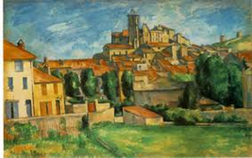
My art work VS His art work
In My art
work I decided to change the color of the buildings roof and I also took away some of the building.

Slide 4
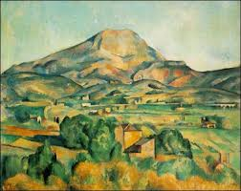
Critique

Slide 5
Art critique

Slide 6
