Slide 1
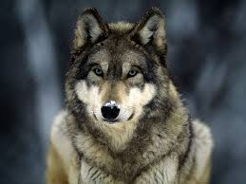
Gray Wolf
By Austin Hembree

Slide 2
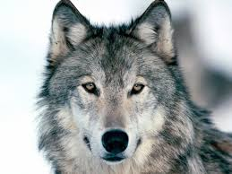
Basic information
Kingdom:
Animalia
Phylum:
Chordata
Class:
Mammalia
Order:
Carnivora
Family:
Canidae
Genus:
Canis
Species:
C. lupus

Slide 3
Physical Description
Height: 26-32 inches at the shoulder.
Length: 4.5-6.5 feet from nose to tip of tail.
Weight: 55-130 lbs. Males are typically heavier and taller than the females.

Slide 4
Cites
http://www.defenders.org/gray-wolf/basic-facts

