Slide 1
All about Me Project
By Austin Hembree

Slide 2
Things about Me
I was born on July 14, 1997
I have brown hair and bright blue eyes
I am a very athletic person

Slide 3
Looks
I am around 5’7” and 120 pounds
I have brown hair that is curly some days and laid down on others
I would be known as handsome to many females

Slide 4
Family
There is my dad, my mom, and my sister
I have what many would call a normal family
My dad is older then my mom and I am older then my sister

Slide 5
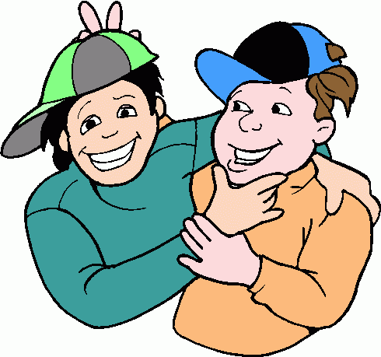
Friends
To be honest I don’t really have just a best friend like most
I have a bunch have friends that I am closer to then others
One of my favorite things to do is to make a new friend

Slide 6
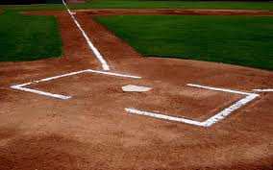
Sports
Sports are a big part in my life
I really enjoy watching any sports, I really enjoy the Olympics
If I could choose one sport to play for the rest of my life it would be baseball

Slide 7
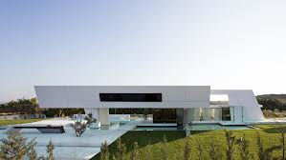
Future
The job I see my self in the future would be doing architecture
I plan to be married
I also plan to have at least one kid

Slide 8
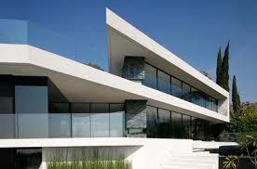
Architecture
I have a passion for architecture
I enjoy looking at buildings and wondering how they were designed or how I could make them better
My favorite type of architecture would be modern

Slide 9
Thoughts
Things that go through my head are strange and random
Some time it is about a girl or I will be thinking about a building design
But for the most part I find myself lost in space

Slide 10
Favorite color
My favorite color forever is blue
I like all the colors of blue
My wardrobe consists mostly of blue colors

Slide 11
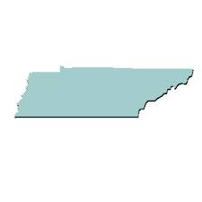
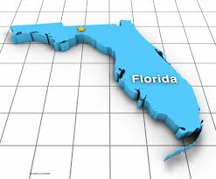
Places I have been
The farthest I have been in the united states is to the Washington
The Farthest down I have been would be Florida
My favorite place I have been is Tennessee

Slide 12
Places I want to go
Ever since I was little I wanted to go to Australia
I don’t know what drives me to want to go but I have always wanted to
Maybe it is to see what it is like somewhere other then the United States

Slide 13
Favorite sports team
My favorite sport team in college is the South Carolina Gamecocks
The fact that the Gamecocks are good in baseball and football really is why I like them
The best part about being a Gamecock fan is being able to brag about beating Clemson

Slide 14
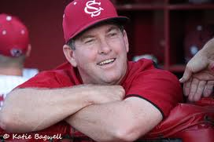
People I’d like to meet
Joey Pancake
Derrick Jeter
Chipper Jones
Ray Tanner
Bobby Cox

Slide 15
Rawlings
My favorite place to get my gloves from would have to be Rawlings
My very first glove I got when I was 6 was a Rawlings so I have grown up with one
Wearing a Rawlings glove just seems to feel different from other gloves

Slide 16
Favorite restaurant
My favorite restaurant to eat at is by far Kobe
They cook your food right in front of you and give you a nice show
Other then looking good the food taste really good every time

Slide 17
Favorite T.V. Show
The show I watch the most would be Sports Center
My favorite part of the show is when they put together the top 10 play
Unlike many shows Sports Center is a very consistent show

Slide 18
Favorite Games
My favorite game to play right now is Call of Duty Black ops 2
It is a game that requires quick reactions and fast thinking
It is a first person shooter made by Treyarch

Slide 19
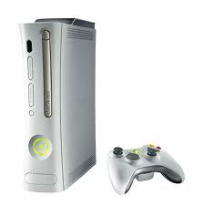
Favorite Console
My favorite home console would be the Xbox 360
I enjoy the experiences I get from playing with other players around the world
Just for the recorded Xbox is better then the PS3

Slide 20
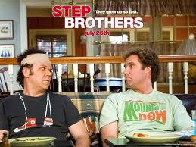
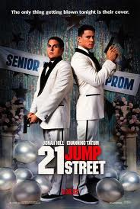
Favorite movies
Step brothers
Other guys
Sandlot
Benchwarmers
Finding Nemo
21 jump street
I am legend

Slide 21
Apple or Android
I have owned both an Apple and an Android
From experience I think Android is so much better
The best thing about Android is the apps are cheaper and the setup is easier

Slide 22
Favorite holiday
My favorite holiday would be New Years Eve
Some of my favorite moments happened on New Years Eve
I enjoy spending time with my friends partying it up

Slide 23
Favorite Scary Movies
Texas chainsaw massacre
Boogie man
Boogie man 2
V/H/S
The devil inside of me
Insidious
Jeepers Creepers

Slide 24
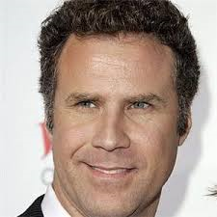
Will Ferrell
My favorite comedy would have to be Will Ferrell
He has stared in some of my favorite movies
I also follow him on twitter so I can read some of his funny tweets

Slide 25
All about Me Project

