Slide 1
All about Me Project
By Austin Hembree

Slide 2
Things about Me
I was born on July 14, 1997
I have brown hair and bright blue eyes
I am a very athletic person

Slide 3
My looks
I am around 5’7” and 120 pounds
I have brown hair that is curly some days and laid down on others
I would be known as handsome to many females

Slide 4
My family
There is my dad, my mom, and my sister
I have what many would call a normal family
My dad is older then my mom and I am older then my sister

Slide 5
My friends
To be honest I don’t really have just a best friend like most
I have a bunch have friends that I am closer to then others
One of my favorite things to do is to make a new friend

Slide 6
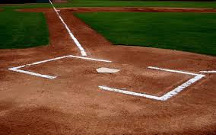
Sports
Sports are a big part in my life
I really enjoy watching any sports, I really enjoy the Olympics
If I could choose one sport to play for the rest of my life it would be baseball

Slide 7
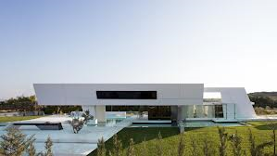
My future
The job I see my self in the future would be doing architecture
I plan to be married
I also plan to have at least one kid

Slide 8
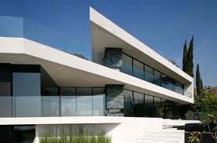
Architecture
I have a passion for architecture
I enjoy looking at buildings and wondering how they were designed
My favorite type of architecture would be modern

Slide 9
My thoughts
Things that go through my head are strange and random
Some time it is about a girl or I will be thinking about a building design
But for the most part I find myself lost in space

Slide 10
My favorite colors
My favorite color forever is blue
I like all the colors of blue
My wardrobe consists mostly of blue colors

Slide 11
Places I have been
The farthest I have been in the united states is to the Washington
The Farthest down I have been would be Florida
My favorite place I have been is Tennessee

Slide 12
Places I want to go

Slide 13
Favorite sports team

Slide 14
Favorite sports

Slide 15
Architecture

